Slide 1
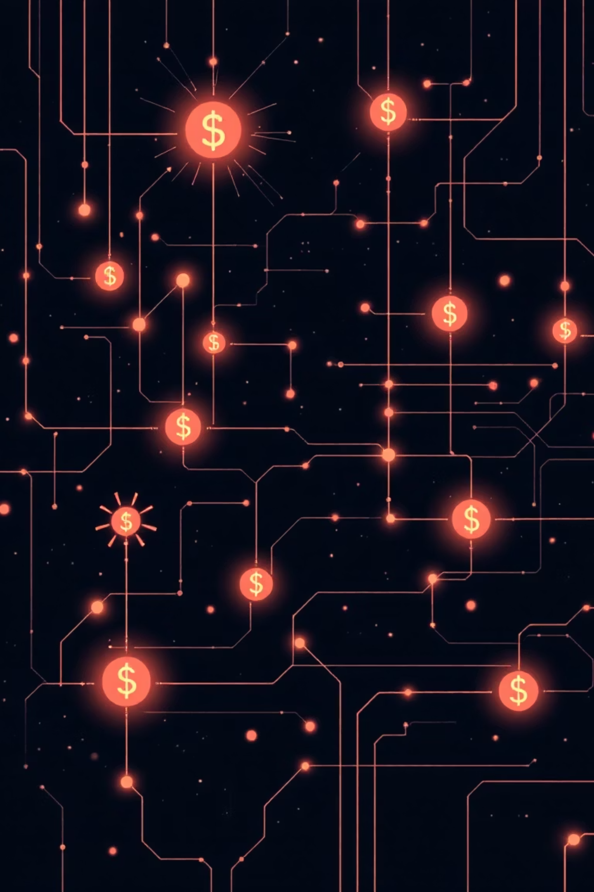

Deep Learning for Financial Fraud Detection
Current Advances, Industry Use Cases, and Future Directions
Manikanta Bobbili | Kent State University
mbobbili@kent.edu

Slide 2




Introduction: The Evolving Threat of Financial Fraud
Financial fraud is a global, ever-changing problem. As transactions move online, fraud becomes more complex, often bypassing traditional rule-based systems.
Digital Shift
Outdated Defenses
Deep Learning's Role
Mobile banking, online shopping, and fast payments increase fraud opportunities.
Old systems struggle against sophisticated, adaptive criminals.
Deep learning excels at finding complex patterns and subtle anomalies in vast datasets.

Slide 3

Background: Financial Fraud in the Digital Age
Deep learning models are designed to catch various types of financial fraud, which involves illegal acts to deceive, manipulate, or steal assets.
Credit Card Fraud
Unauthorized use of card information, often starting with small test purchases.
Account Takeover (ATO)
Criminals gaining control of legitimate accounts through phishing or stolen credentials.
Money Laundering
Complex transfers to hide illicit funds, forming intricate networks.
Synthetic Identity Fraud
Creating fake identities using mixed real and fabricated data, building trust over time.

Slide 4
Deep Learning Techniques: Evolution of Fraud Detection
From basic neural networks to advanced graph-based models, deep learning has transformed fraud detection.
Early Neural Networks
1
Feedforward networks for tabular data, good for non-linear patterns but limited in relationships and time.
2
Autoencoders
Unsupervised anomaly detection, effective for highlighting unusual behaviors without labeled fraud data.
Recurrent Neural Networks (RNNs)
3
Capture temporal dynamics in transaction sequences, better for evolving fraud patterns.
4
Graph Neural Networks (GNNs)
Modern breakthrough for detecting networked fraud, identifying suspicious relationships and rings.
Transformers
5
Attention-based models for long transaction histories, identifying subtle irregularities.

Slide 5

GNNs: Uncovering Networked Fraud
Graph Neural Networks (GNNs) are crucial for detecting fraud, as fraudsters often collaborate, forming complex networks.
Why GNNs Fit Fraud Detection Perfectly
Represent entities (customers, devices) and relationships (transactions, shared attributes) as graphs.
Propagate information to learn suspicious account relationships and fraudulent rings.
Types of GNNs
Heterogeneous GNNs: Handle diverse node and edge types.
Temporal GNNs: Track evolving relationships over time.

Slide 6

Transformers: Mastering Sequential Data
Transformers, with their self-attention mechanism, have become the leading sequence models, surpassing RNNs in fraud detection.
Benefits in Fraud Detection
Model long transaction histories without RNN limitations.
Highly parallelizable for efficient processing.
Effectively integrate behavioral and temporal cues.
Identifying Irregularities
Spikes in spending frequency.
Abnormal merchant switching.
Unusual sequence irregularities before fraud events.

Slide 7





Industry Applications: Deep Learning in Action
Deep learning is widely adopted across the financial sector to combat various forms of fraud.
Banking & Credit Cards
Real-time scoring, detecting unusual spending, and ATM skimming patterns.
Fintech & Digital Wallets
Detecting first-party fraud, device anomalies, and synthetic identities in dynamic environments.
E-Commerce Platforms
Identifying seller fraud, fake listings, return fraud, and coupon abuse.
Insurance & Claims
Analyzing structured and unstructured data (text, images) for false claims and staged accidents.

Slide 8





Challenges & Limitations
Despite advancements, deep learning in fraud detection faces significant hurdles.
Data Imbalance
Explainability
Concept Drift
Fraud is rare, leading to skewed models. Techniques like oversampling and cost-sensitive learning are used.
Difficulty in understanding how complex models like Transformers and GNNs reach conclusions, impacting regulatory compliance.
Fraud tactics constantly evolve, requiring continuous model retraining and monitoring.
Privacy & Data Sharing
AI by Fraudsters
Restrictions on sharing customer data hinder collaborative fraud detection efforts.
Criminals use AI for deepfakes, synthetic identities, and automated phishing, demanding rapid evolution of defenses.

Slide 9
Future Directions: Evolving Fraud Detection
The future of fraud detection will be shaped by emerging research trends, enhancing accuracy and adaptability.
Dynamic Graph Transformers
Real-time graph updates for adaptive fraud ring detection and improved temporal reasoning.
Causal Modeling
Distinguishing true fraud indicators from spurious correlations for enhanced robustness and interpretability.
Multimodal Systems
Combining transaction data, text, images, voice, and device behavior for holistic analysis.
Federated Learning
Privacy-preserving collaboration among institutions without sharing raw data.
Human-AI Collaboration
Integrating AI recommendations with human oversight for improved efficiency and judgment.

Slide 10

Conclusion: Securing the Digital Financial Landscape
Deep learning has revolutionized financial fraud detection, moving from simple rules to sophisticated, adaptive systems.
Transformative Impact
Ongoing Challenges
Deep learning models learn complex behaviors, track money flows, and adapt to new threats.
Issues like explainability, data imbalance, and evolving fraud tactics persist.
Future Outlook
Integration of causal models, multimodal data, and privacy-preserving tech will enhance future systems.
As financial systems grow in complexity, intelligent, adaptable fraud detection remains crucial for safeguarding our money and online ecosystems.

